Slide 1

Relational Algebra
Notes:
1
The slides for this text are organized into chapters. This lecture covers relational algebra, from Chapter 4. The relational calculus part can be found in Chapter 4, Part B.
Examples are used extensively. The text and chapter exercises contain numerous additional examples, and I often ask students to do several of these as assignments.
This material is important for two reasons:
It is a foundation for SQL. This is an important reason to cover algebra in detail, but the discussion of SQL in the book does NOT depend on a detailed understanding of algebra. Instructors who prefer to explain the basic algebra operators and skip the discussion of how to write a wide range of queries in algebra can safely do so.
It is a foundation for query processing. Students need to know what each operator does, and how they can be composed in queries. Again, it is possible to skip a detailed discussion of how to write complex queries in algebra, and this is left to the instructor’s discretion.

Slide 2
Relational Query Languages
Query languages: Allow manipulation and retrieval of data from a database.
Relational model supports simple, powerful QLs:
Strong formal foundation based on logic.
Allows for much optimization.
Query Languages != programming languages!
QLs not expected to be “Turing complete”.
QLs not intended to be used for complex calculations.
QLs support easy, efficient access to large data sets.
Notes:
2

Slide 3
Formal Relational Query Languages
Two mathematical Query Languages form the basis for “real” languages (e.g. SQL), and for implementation:
Relational Algebra: More operational (procedural), very useful for representing execution plans.
Relational Calculus: Lets users describe what they want, rather than how to compute it: Non-operational, declarative.

Slide 4
Preliminaries
A query is applied to relation instances, and the result of a query is also a relation instance.
Schemas of input relations for a query are fixed.
The schema for the result of a given query is also fixed! - determined by definition of query language constructs.
Positional vs. named-field notation:
Positional notation easier for formal definitions, named-field notation more readable.
Both used in SQL
Notes:
4

Slide 5
Example Instances
R1
“Sailors” and “Reserves” relations for our examples.
We’ll use positional or named field notation, assume that names of fields in query results are `inherited’ from names of fields in query input relations.
S1
S2
Notes:
5

Slide 6
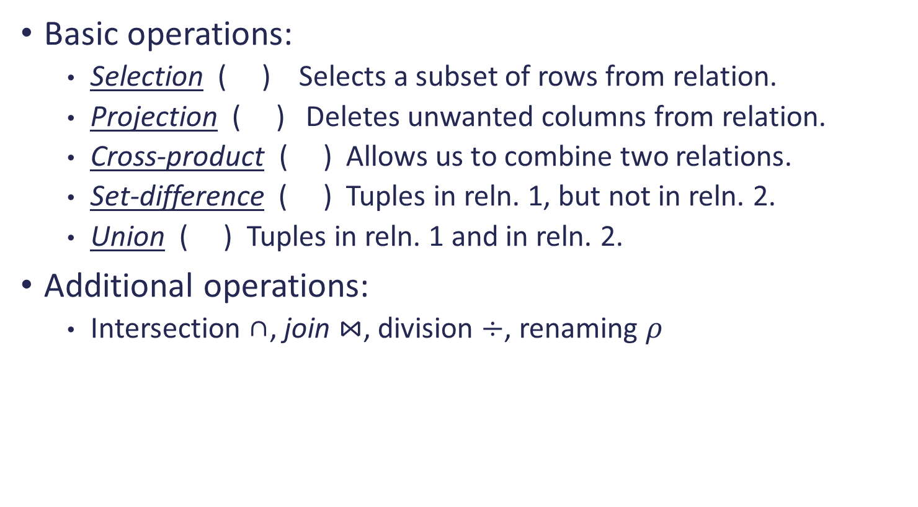
Relational Algebra
Basic operations:
Selection ( ) Selects a subset of rows from relation.
Projection ( ) Deletes unwanted columns from relation.
Cross-product ( ) Allows us to combine two relations.
Set-difference ( ) Tuples in reln. 1, but not in reln. 2.
Union ( ) Tuples in reln. 1 and in reln. 2.
Additional operations:
Intersection ∩, join $⋈$, division $÷$, renaming $ρ$
Notes:
6

Slide 7
Projection
Deletes attributes that are not in projection list.
Schema of result contains exactly the fields in the projection list, with the same names that they had in the input relation.
Projection operator has to eliminate duplicates! Why?
Note: real systems typically don’t do duplicate elimination unless the user explicitly asks for it (by DISTINCT). Why not?
Notes:
7

Slide 8
Selection
Selects rows that satisfy selection condition.
No duplicates in result! Why?
Schema of result identical to schema of input relation.
What is Operator composition?
Selection is distributive over binary operators
Selection is commutative
Notes:
8

Slide 9
Union, Intersection, Set-Difference
All of these operations take two input relations, which must be union-compatible:
Same number of fields.
`Corresponding’ fields have the same type.
What is the schema of result?
Notes:
9

Slide 10
Cross-Product (Cartesian Product)
Each row of S1 is paired with each row of R1.
Result schema has one field per field of S1 and R1, with field names `inherited’ if possible.
Conflict: Both S1 and R1 have a field called sid.
Renaming operator:
Notes:
10

Slide 11
Joins: used to combine relations
Condition Join:
Result schema same as that of cross-product.
Fewer tuples than cross-product, might be able to compute more efficiently
Sometimes called a theta-join.
Notes:
11

Slide 12
Join
Equi-Join: A special case of condition join where the condition c contains only equalities.
Result schema similar to cross-product, but only one copy of fields for which equality is specified.
Natural Join: Equijoin on all common fields.
Notes:
12

Slide 13
Properties of join
Selecting power: can join be used for selection?
Is join commutative? = ?
Is join associative?
Join and projection perform complementary functions
Lossless and lossy decomposition
Notes:
12

Slide 14
Division
Not supported as a primitive operator, but useful for expressing queries like: Find sailors who have reserved all boats.
Let A have 2 fields, x and y; B have only field y:
A/B =
i.e., A/B contains all x tuples (sailors) such that for every y tuple (boat) in B, there is an xy tuple in A.
Or: If the set of y values (boats) associated with an x value (sailor) in A contains all y values in B, the x value is in A/B.
In general, x and y can be any lists of fields; y is the list of fields in B, and x y is the list of fields of A.
Notes:
13

Slide 15
Examples of Division A/B
B1
B2
B3
A
A/B1
A/B2
A/B3
Notes:
14

Slide 16
Example of Division
Find all customers who have an account at all branches located in Chville
Branch (bname, assets, bcity)
Account (bname, acct#, cname, balance)
Notes:
14

Slide 17
Example of Division
R1: Find all branches in Chville
R2: Find (bname, cname) pair from Account
R3: Customers in r2 with every branch name in r1
Notes:
14

Slide 18
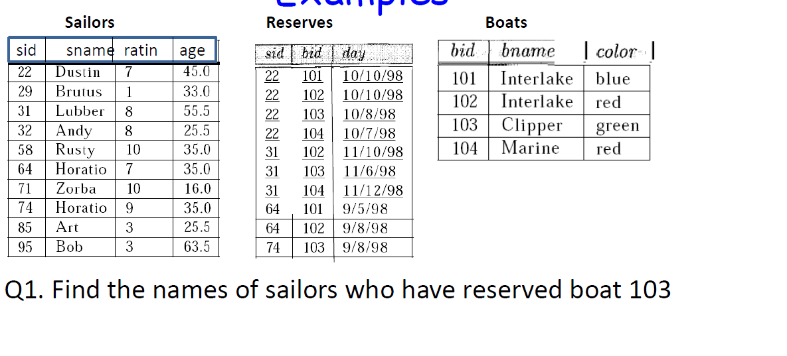
Exercises
Given relational schema:
Sailors (sid, sname, rating, age)
Reservation (sid, bid, date)
Boats (bid, bname, color)
Notes:
16

Slide 19
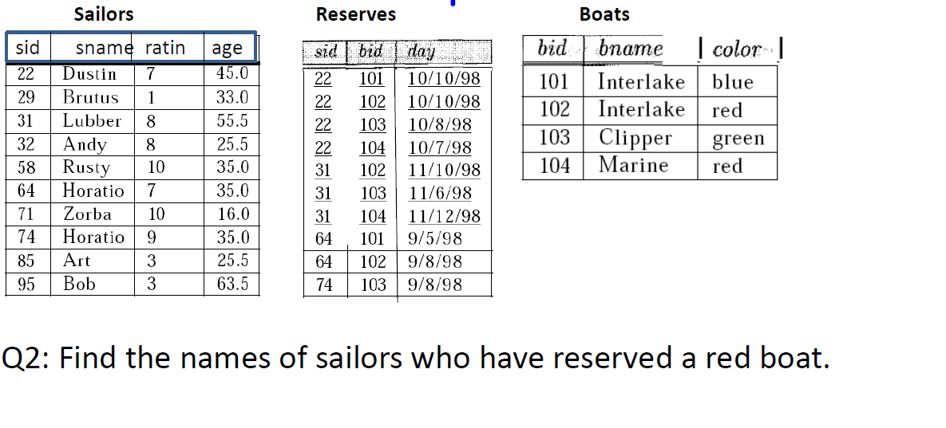
Exercises

Slide 20
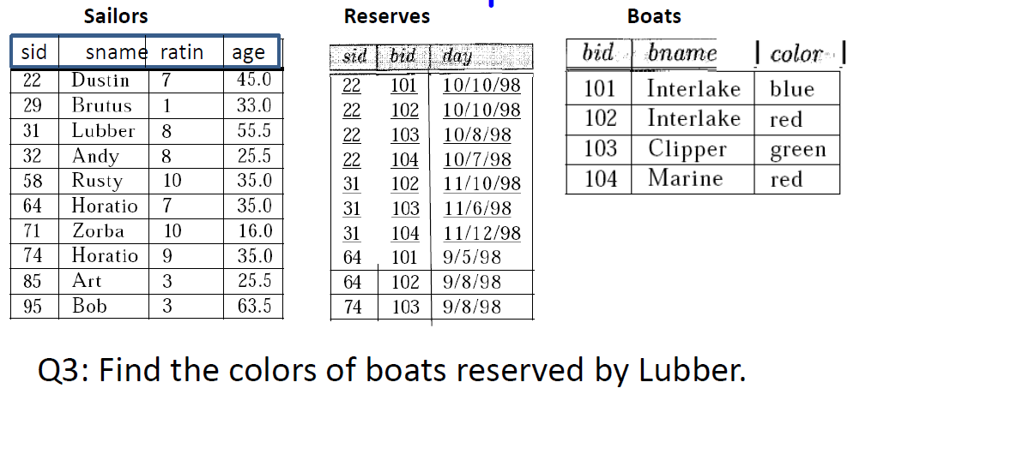
Exercises

Slide 21
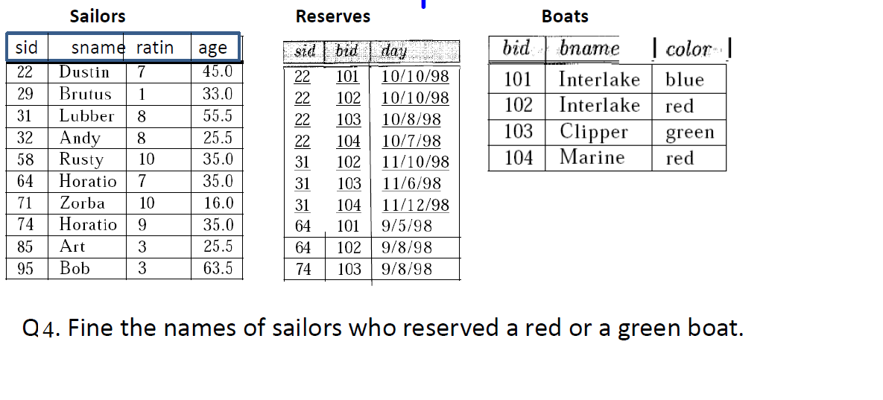
Exercises

Slide 22
Exercises
Find sailors who’ve reserved a red and a green boat
Find the names of sailors who’ve reserved all boats

Slide 23
Lecture 5 Relational Algebra Exercise
Notes:
1
The slides for this text are organized into chapters. This lecture covers relational algebra, from Chapter 4. The relational calculus part can be found in Chapter 4, Part B.
Examples are used extensively. The text and chapter exercises contain numerous additional examples, and I often ask students to do several of these as assignments.
This material is important for two reasons:
It is a foundation for SQL. This is an important reason to cover algebra in detail, but the discussion of SQL in the book does NOT depend on a detailed understanding of algebra. Instructors who prefer to explain the basic algebra operators and skip the discussion of how to write a wide range of queries in algebra can safely do so.
It is a foundation for query processing. Students need to know what each operator does, and how they can be composed in queries. Again, it is possible to skip a detailed discussion of how to write complex queries in algebra, and this is left to the instructor’s discretion.

Slide 24
Exercises
1. Consider a database with the following schema:
Person ( name, age, gender ) name is a key
Frequents ( name, pizzeria ) (name, pizzeria) is a key
Eats ( name, pizza ) (name, pizza) is a key
Serves ( pizzeria, pizza, price ) (pizzeria, pizza) is a key

Slide 25
Exercises
a. | Find all pizzerias frequented by at least one person under the age of 18.
b. | Find the names of all females who eat either mushroom or pepperoni pizza (or both).
c. | Find the names of all females who eat both mushroom and pepperoni pizza.
d. | Find all pizzerias that serve at least one pizza that Amy eats for less than $10.00.
e. | Find all pizzerias that are frequented by only females or only males.
f. | For each person, find all pizzas the person eats that are not served by any pizzeria the person frequents. Return all such person (name) / pizza pairs.
g. | Find the names of all people who frequent only pizzerias serving at least one pizza they eat.
h. | Find the names of all people who frequent every pizzeria serving at least one pizza they eat.
i. | Find the pizzeria serving the cheapest pepperoni pizza. In the case of ties, return all of the cheapest-pepperoni pizzerias.

Slide 26
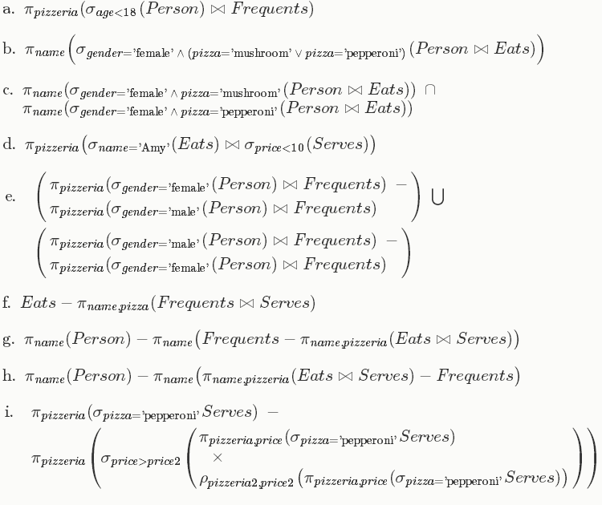
Answers

Slide 27
Exercises
Consider the given relational database, where the primary keys are underlined.

Slide 28
Exercises
a. Find the names of all employees who work for First Bank Corporation.
b. Find the names and cities of residence of all employees who work for First Bank Corporation.
c. Find the names, street address, and cities of residence of all employees who work for First Bank Corporation and earn more than $10,000 per annum.
d. Find the names of all employees in this database who live in the same city as the company for which they work.
e. Find the names of all employees who live in the same city and on the same street as do their managers.
f. Find the names of all employees in this database who do not work for First Bank Corporation.
g. Find the names of all employees who earn more than every employee of Small Bank Corporation.
h. Assume the companies may be located in several cities. Find all companies located in every city in which Small Bank Corporation is located.

Slide 29
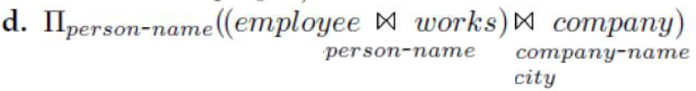
Answers

